Slide 1
CSS143 Computer Programming (II)

Slide 2
Java Basics
Code-A-Along
Review & practice programming
Homework sample and format
First homework will be announced later tonight

Slide 3
Java Basics
Write a function to find the maximum number in an integer array
Write a function to find the maximum number in an integer array

Slide 4
Java Basics
Write a function to find the maximum number in an integer array
Input: A array of Integers
12
12
1
7
18
18
10
3
0
1
2
3
4
5
6

Slide 5
Java Basics
Write a function to find the maximum number in an integer array
Input: A array of Integers
-9
-1
-1
-2
-7
0
1
2
3

Slide 6

Java Basics
Write a function to find the maximum number in an integer array
max
variable
$$i$$
int max;
0
18
1
2
3
4
5
6
12
12
12
12
18
18
18
max = values[0];
Return value
values
12
12
1
7
18
10
3
0
1
2
3
4
5
6
int values[]={12, 12, 1, 7, 18, 10, 3}

Slide 7
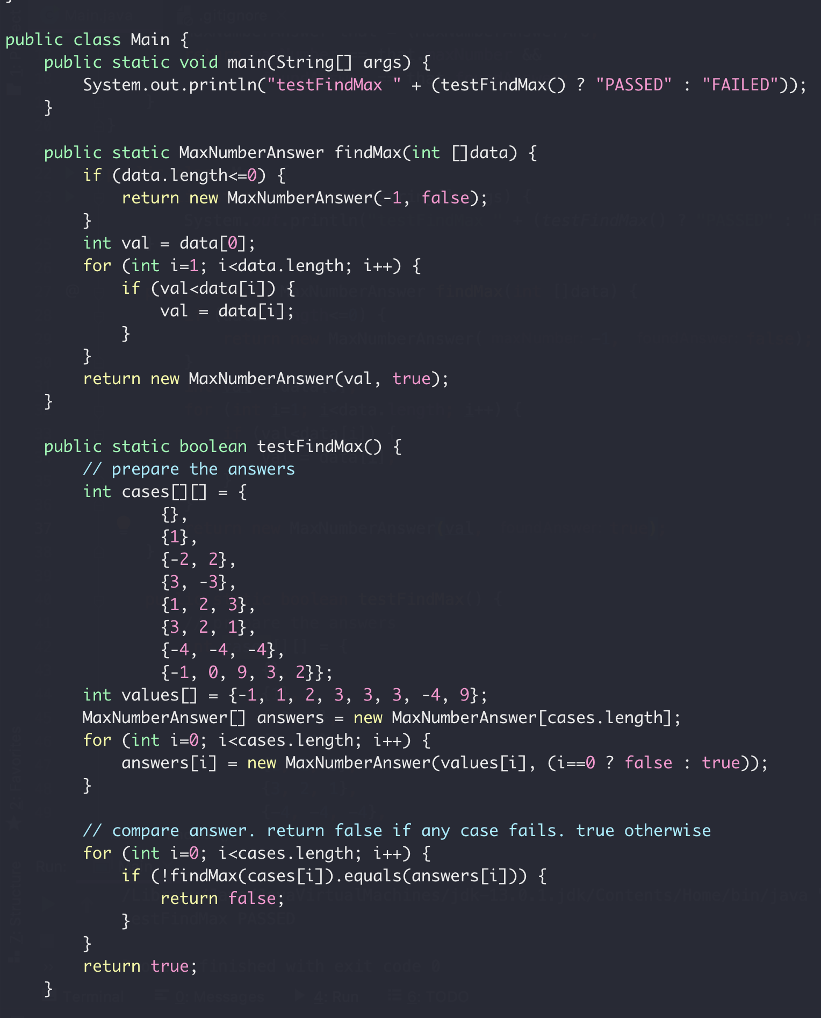
Java Basics
Driver
Feature
Tests

Slide 8
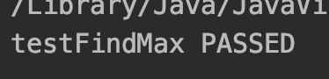
Java Basics
About testing output
If test passes, output like:
If test fails, output like:

Slide 9
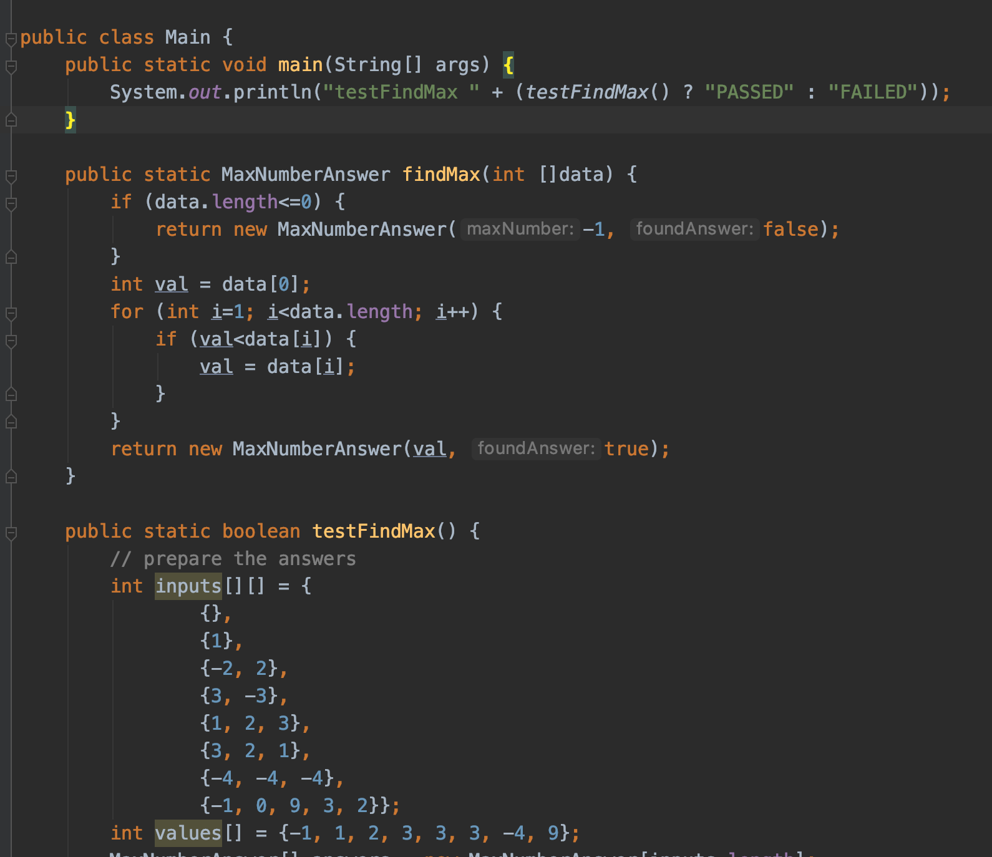
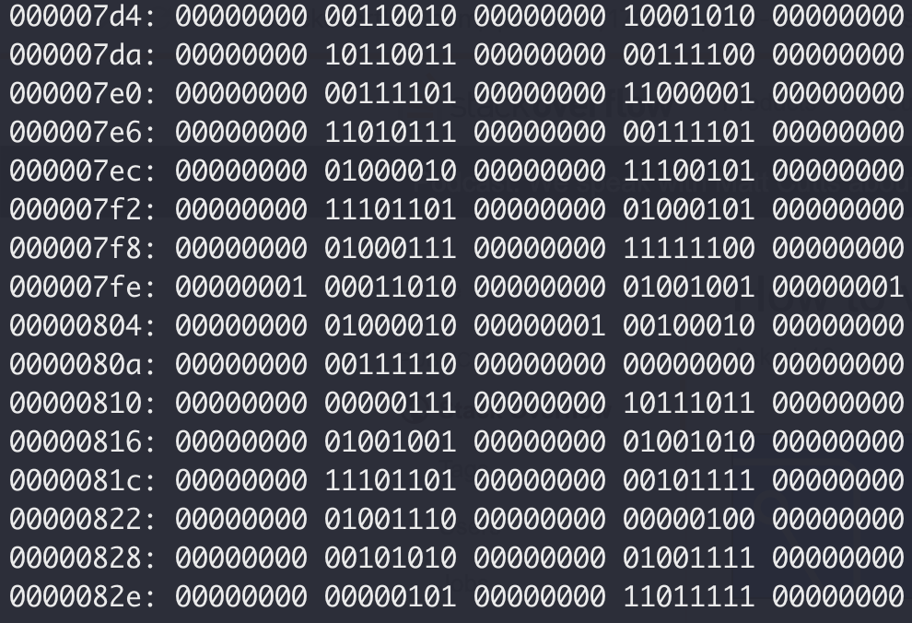
Java Basics
Run Code
Compiler
xxd -b Main.class

Slide 10
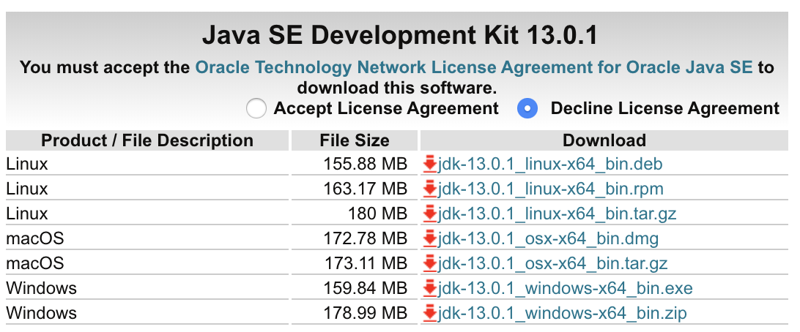
Java Basics
Run Java Code
bytecode
Compiler
xxd -b Main.class

Slide 11
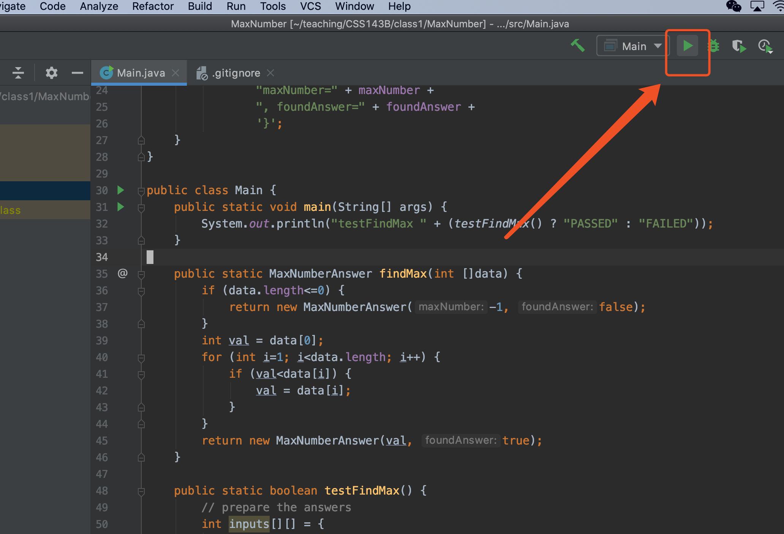
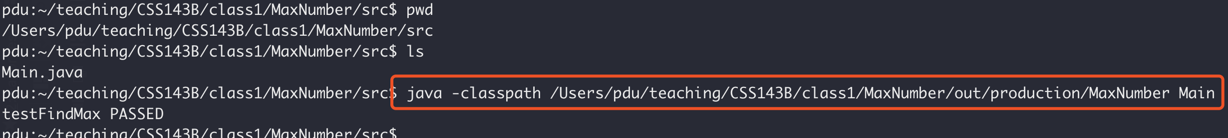
Java Basics
Option 1:
Run Java Code
Option 2:

Slide 12
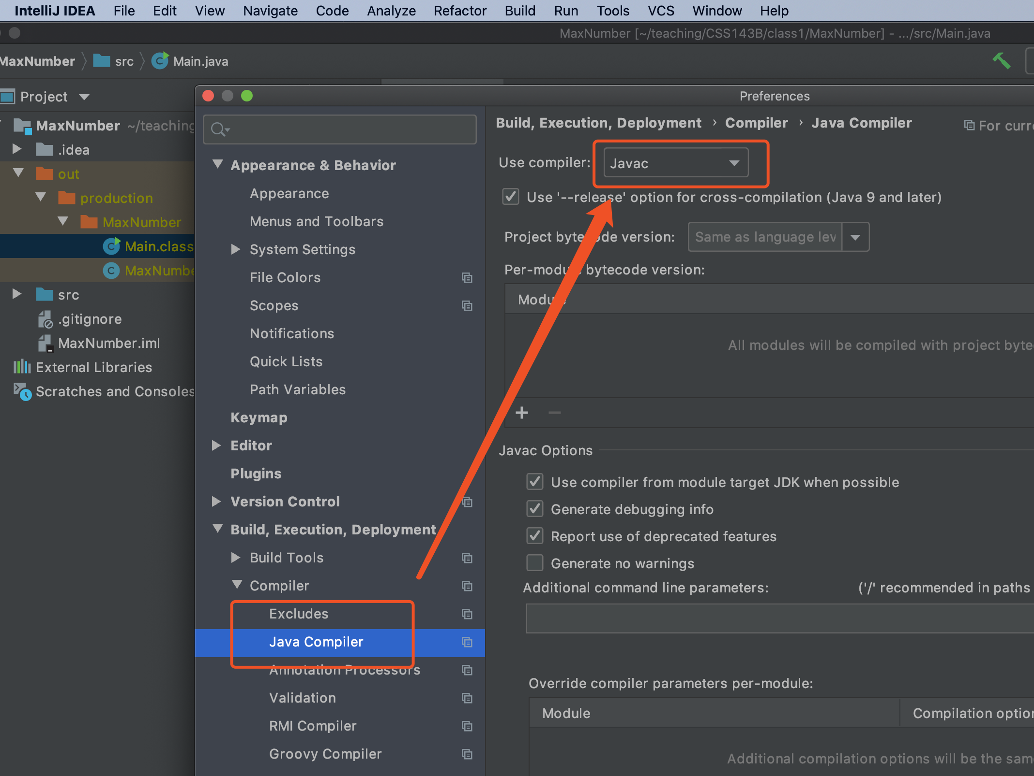
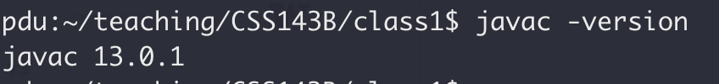
Java Basics
Run Java Code
Quiz:
What program compiles JAVA source code to
machine readable bytecode?
A: an IDE (such as Eclipse or Intellij)
B: a Java compiler
B: a Java compiler
C: operating system (like Mac or Windows)
D: text editor (like vim or Sublime Text)

Slide 13
Java Basics
Write a function to find the maximum number in an integer array
How many comparisons?
Best case:
1
Worse case:
N
Can we do better?

Slide 14
Java Basics
Write a function to find the maximum number in an integer array
Data Structure
Algorithm
https://en.wikipedia.org/wiki/Heap_(data_structure)

Slide 15
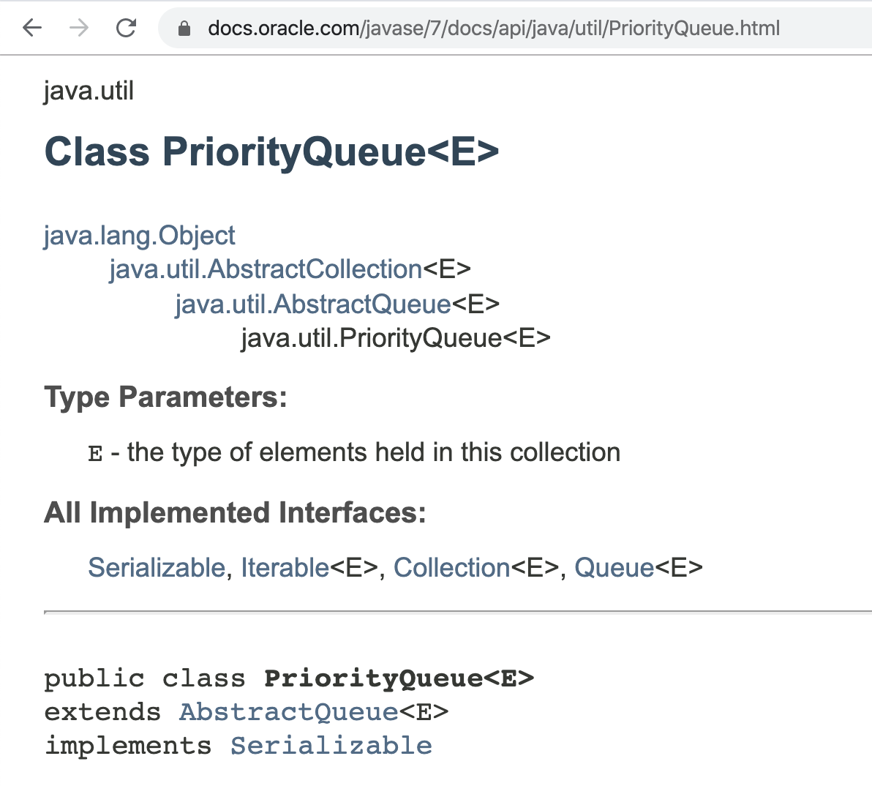
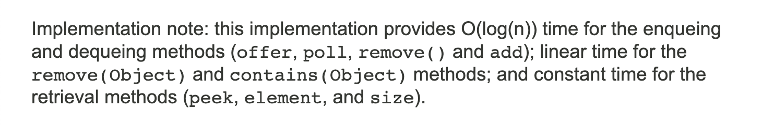
Java Basics
Write a function to find the maximum number in an integer array

Slide 16
Java Basics
Write a function to reverse an integer array

Slide 17

Java Basics
Write a function to reverse an integer array in place
Write a function to reverse an integer array

Slide 18
Java Basics
Write a function to reverse an integer array in place
5
3
12
10
1
18
7
7
18
1
10
12
3
Input:
5
output:
0
1
2
3
4
5
6
0
1
2
3
4
5
6
“in place” means “without using additional memory space”

Slide 19
Java Basics
Write a function to reverse an integer array in place
Write down your test cases
Write down your test cases
reverse twice, it’ll be back to the input
1,3,5 → 5, 3, 1 → 1,3,5
Okay, now think how reverse work

Slide 20
Java Basics
Write a function to reverse an integer array in place
Swap
Swap
5
18
7
12
1
7
18
12
5
0
1
2
3
4

Slide 21
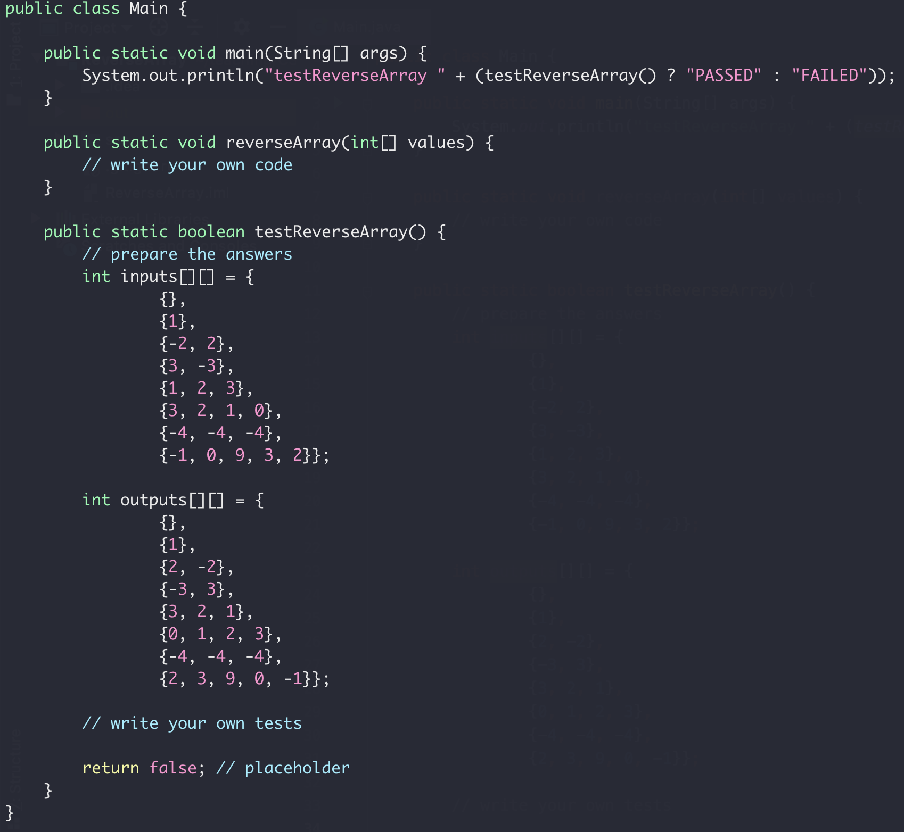
Java Basics
Driver
Write a function to reverse an integer array in place
Feature
Tests

Slide 22
Java Basics
Download the starter code here
https://github.com/pdgetrf/CSS143B/tree/master/class1/ReverseArray/src

Slide 23
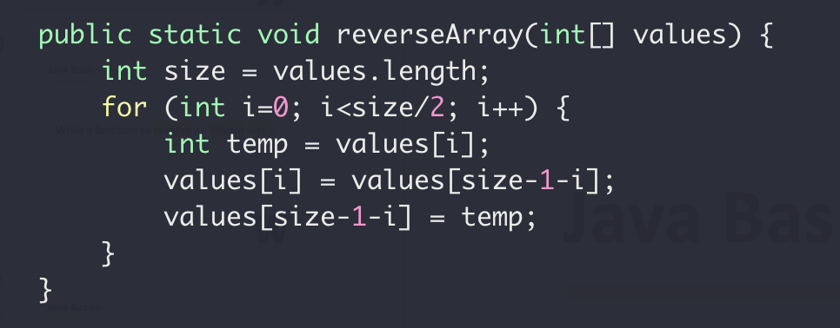
Java Basics
Write a function to reverse an integer array in place
Fun challenge: can you achieve the swap without extra variable?

Slide 24
Java Basics
Swap two numbers without temp variable
a’ = a - b b’ = b’ + a’ a’’ = b’ – a’
Doesn’t work when a == b to start with

Slide 25
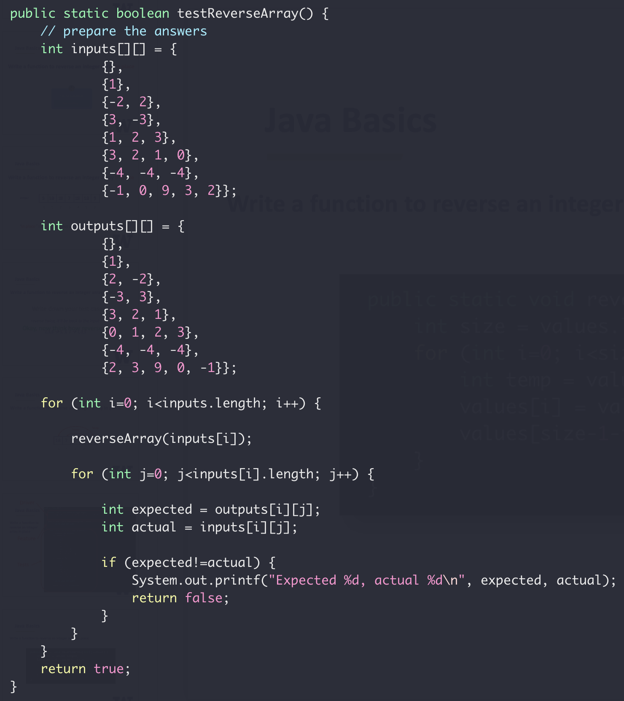
Java Basics
Write a function to reverse an integer array in place

Slide 26

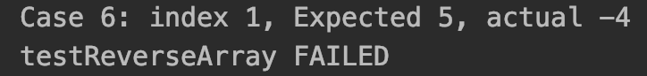
Java Basics
About testing output
If test passes, output:
If test fails, output:

Slide 27
Next Week
Monday:
Java Class
Wednesday
Abstract Data Type (ADT)

